Slide 1

Event Maker Web Application
Made by Team 5 (G3)

Slide 2
Table of contents
Team
Introduction
ER Diagram
Functionalities
Demo Project

Slide 3
My Teams
Nuon Uteytithya : Handle controller and routing
Ou Venhav: Handle resources and public assets
Ratana Madarine: Handle migration, model and seeder

Slide 4
Introduction
EventMaker is an easy access to plan and manage your own events with user being their own manager.

Slide 5
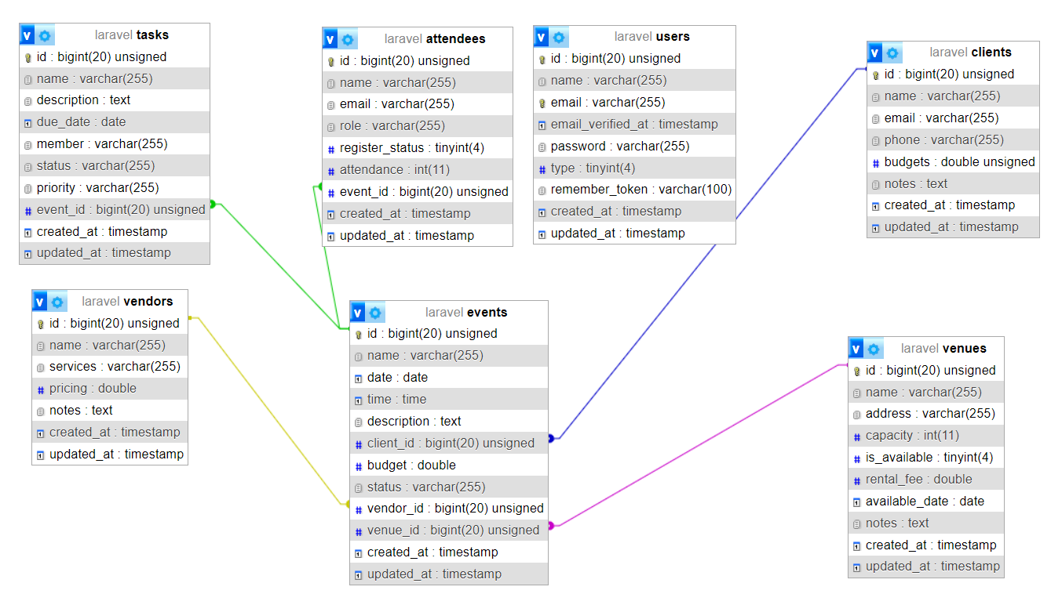
ER Diagram

Slide 6
Technology ( Beside Laravel )
Breeze
Bootstrap ui
Vite

Slide 7
Functionalities
CRUD Operation
Log in/Register/Log Out
Routing with authentication
Dashboard
Home

Slide 8
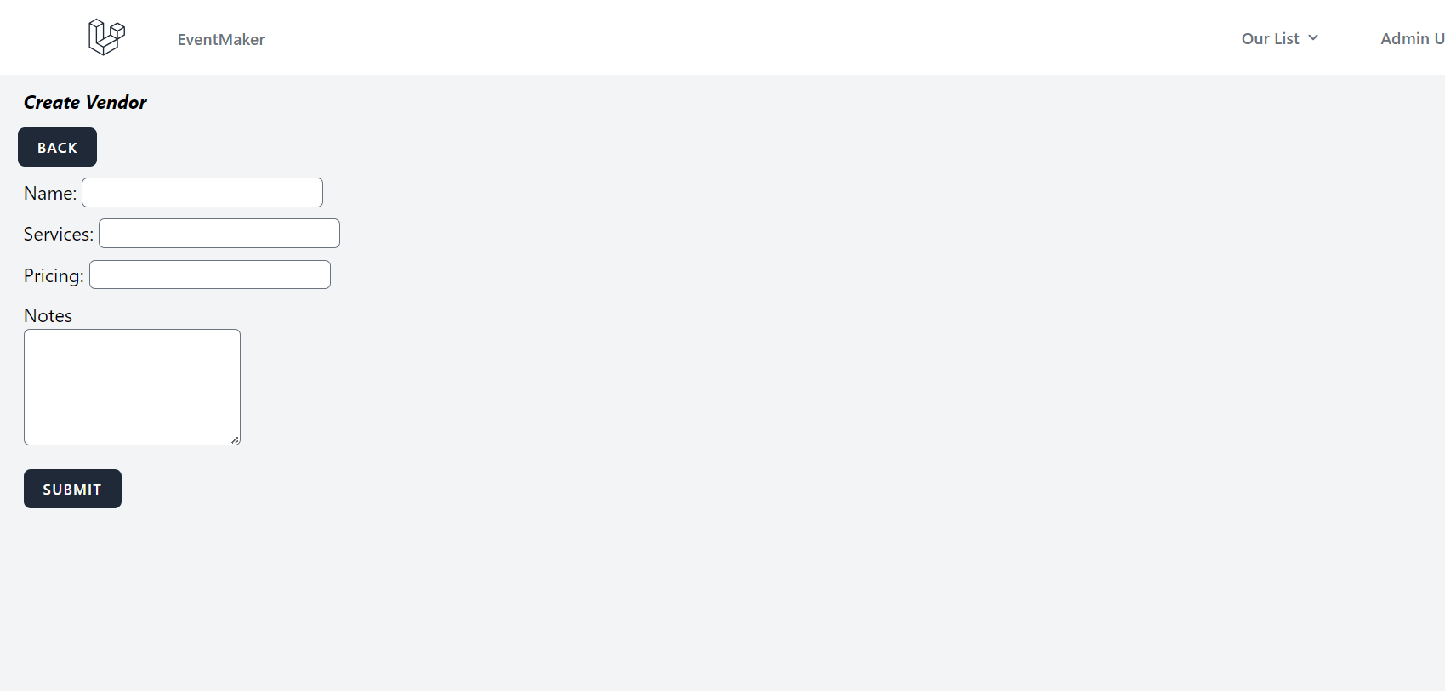
Function (CRUD)

Slide 9
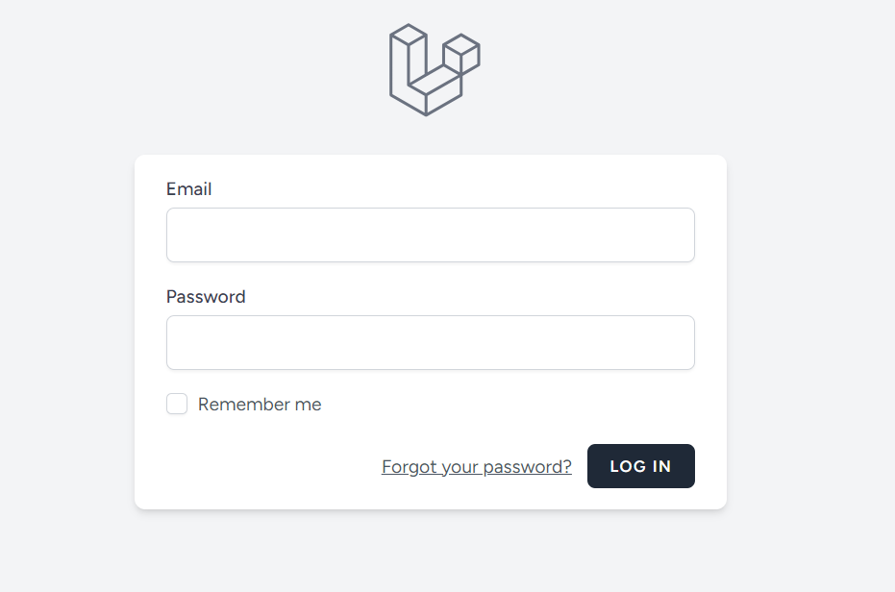
Function ( Login )

Slide 10
Demo Project

Slide 11
Conclusion
Thank You
Our github repository: https://github.com/Zeinsss/laravel_project.git

